Slide 1
Apex Installation Steps: Link youtube tutorial:https://youtu.be/PECSxJ8xo4s
Download Apex latest & Unzip: Download Link
Step 1. Open command prompt “Run as administrator” . Change directory where all apex scripts are present in the unzipped location of apex (~\apex_22.1\apex). Login database where you want to install. Login using sys as sysdba

Slide 2
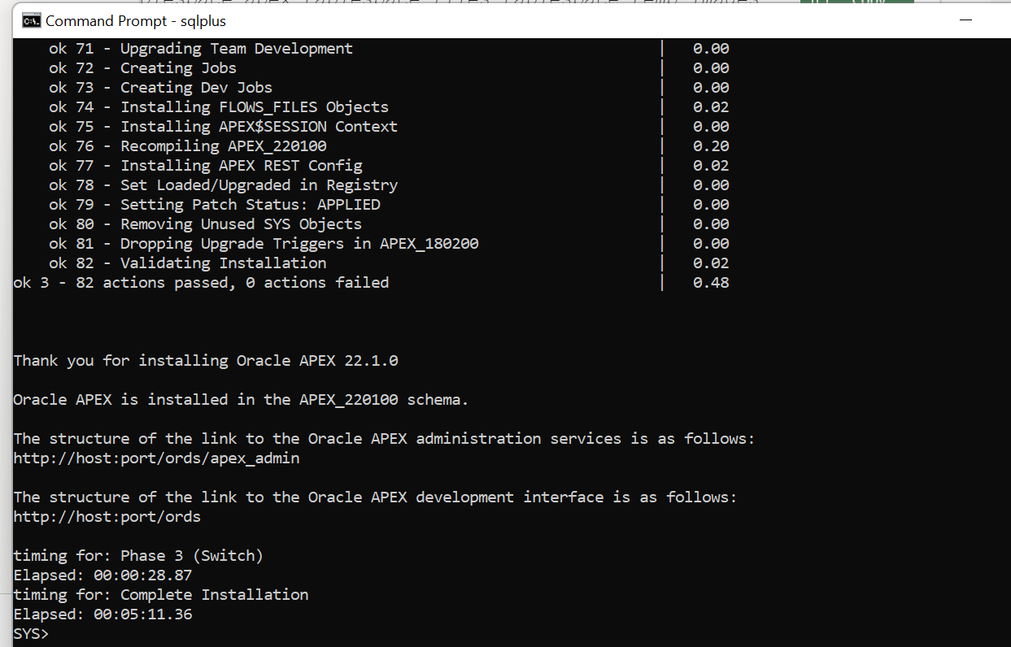
Oracle Apex Setup: Step 1
Step 2: @apexins.sql SYSAUX SYSAUX TEMP /i/

Slide 3
Oracle Apex Setup: Step 2
Execute this script, which enables you to create your Instance Admin. istrator account. You have to provide administrator name, email & strong password with punctuation.
@apxchpwd.sql

Slide 4
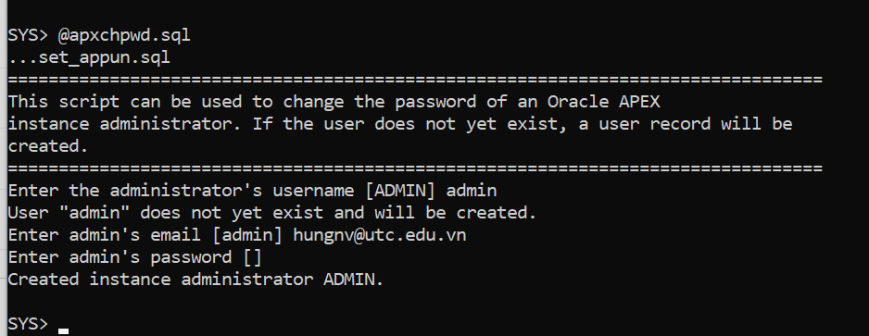
Creating or Updating Your Instance Administration Account
@apxchpwd.sql
You must run the apxchpwd.sql script in the following scenarios:
New Oracle APEX installations - Run apxchpwd.sql to create an Instance Administrator account and password.
Converting of a runtime environment to a development environment - Run apxchpwd.sql to change the Instance Administrator account password.
Changing Your Instance Administrator Password -Run apxchpwd.sql to change the password for an existing Instance Administrator account.
Unlocking Your Instance Administrator Account - Run apxchpwd.sql to unlock an existing Instance Administrator account.
Admin/Abc123456!

Slide 5
Setting up APEX_PUBLIC_USER
Oracle Apex Setup: Step 3
ALTER USER APEX_PUBLIC_USER ACCOUNT UNLOCK; ALTER USER APEX_PUBLIC_USER IDENTIFIED BY <PASSWORD>;

Slide 6
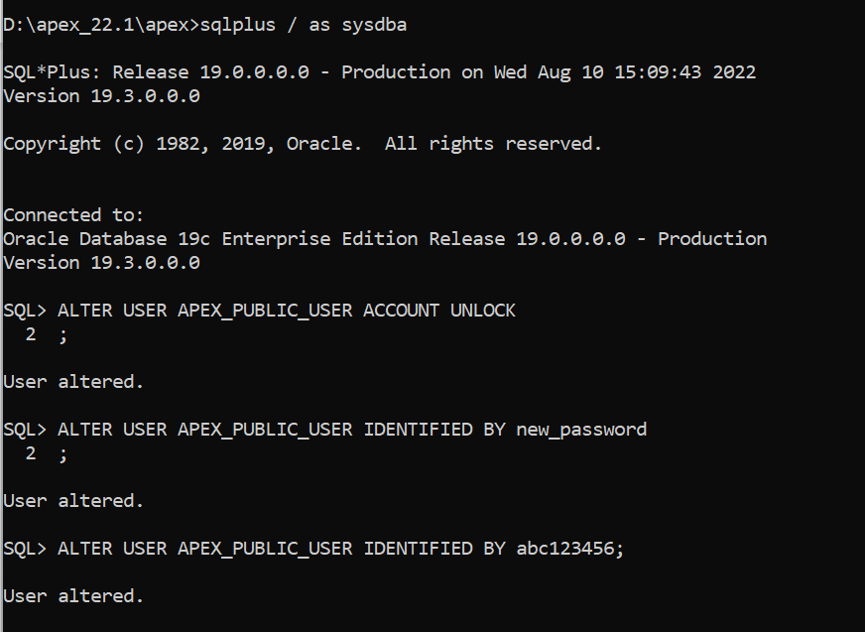
Unlocking the APEX_PUBLIC_USER Account

Slide 7
Configure RESTfull Services. Here we need to provide password for users : APEX_LISTENER & APEX_REST_PUBLIC_USER
Oracle Apex Setup: Step 4
@apex_rest_config.sql
select * from all_users where username like ‘%APEX%’ ;
select * from all_users where username like ‘%FLOWS%’ ;
Here Apex Installation is done. Just check schema created by the apex installation. Next step is to setup web listener

Slide 8
ORDS Installation:
Oracle REST Data Services (ORDS) – Java EE based RESTful service which is used to replace Oracle HTTP server and mod_plsql. Download ORDS: Link
Step 1: Created conf folder to hold ords configuration : D:\ords\config
Step 2: Download and Setup JDK. Link
Step 3. Change directory where ords.war is present & run below command
java -jar ords.war --config D:/ords/config install

Slide 9
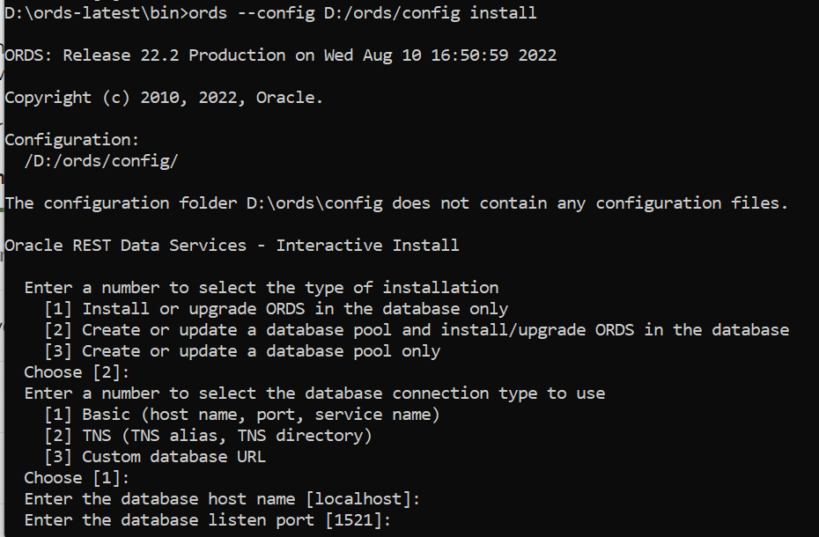
Step 3: Setup ORDS (Oracle Rest Data Services)
ords --config D:/ords/config install

Slide 10
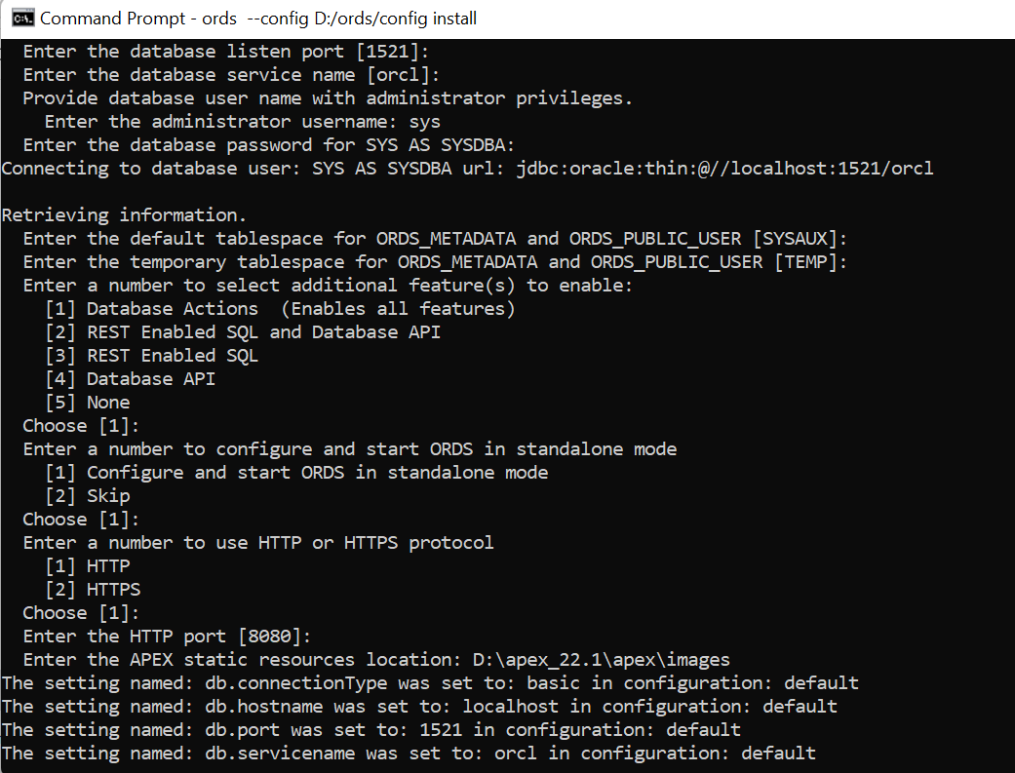
In step Enter the APEX static resources location: <path to the folder images in setup folder>

Slide 11
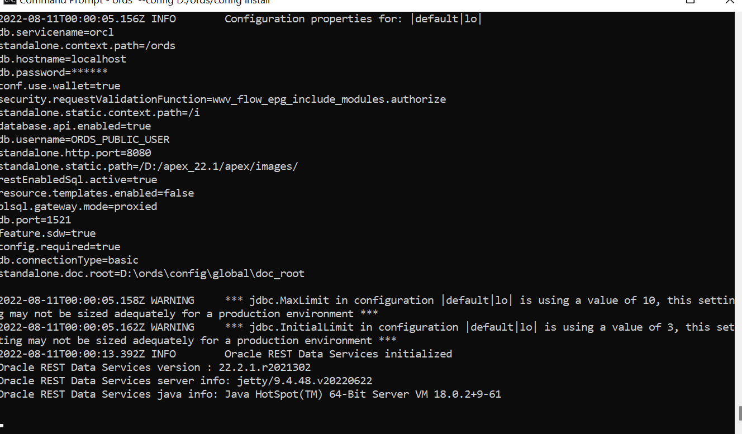
Success Install!

Slide 12
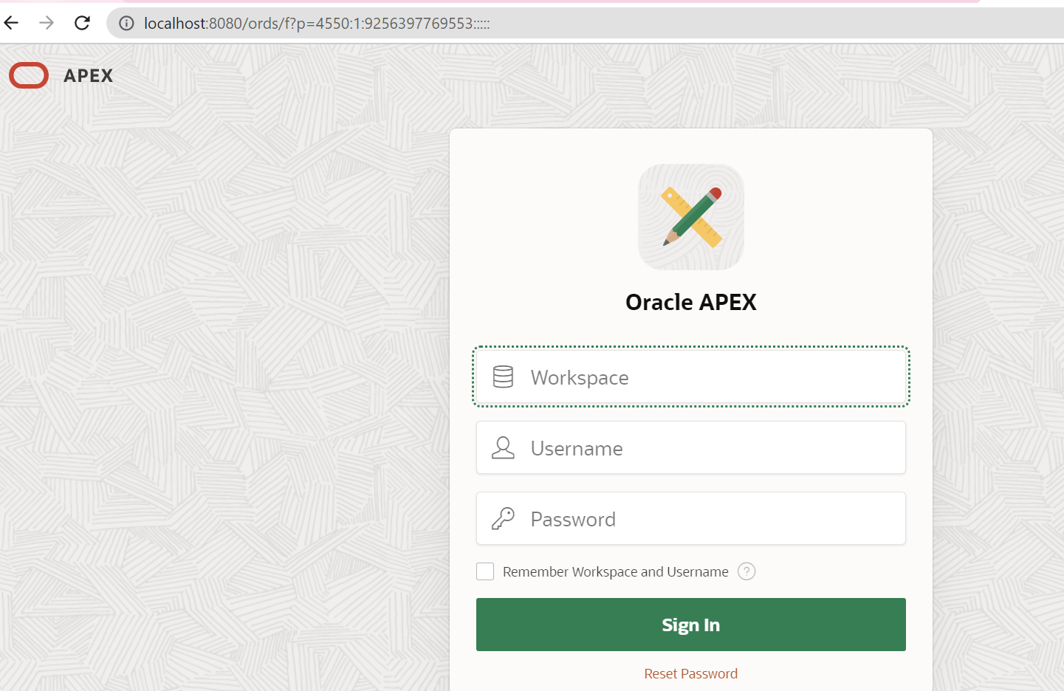
On the browers: Enter: localhost:8080/ords
Create Workspace & Start working on low-code development of application.

Slide 13
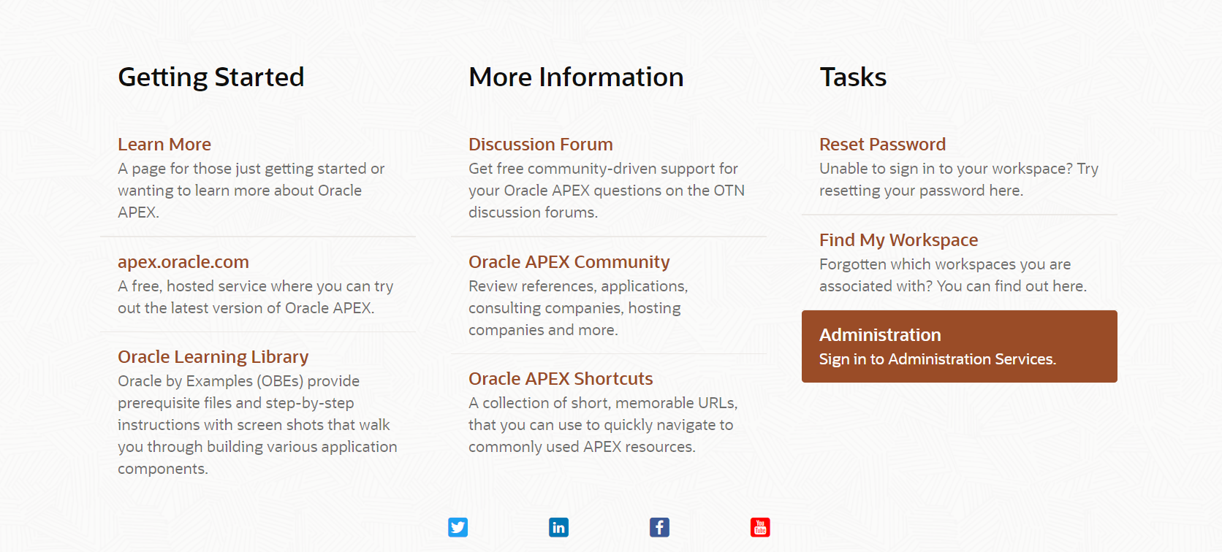
Go to Administration page:

Slide 14
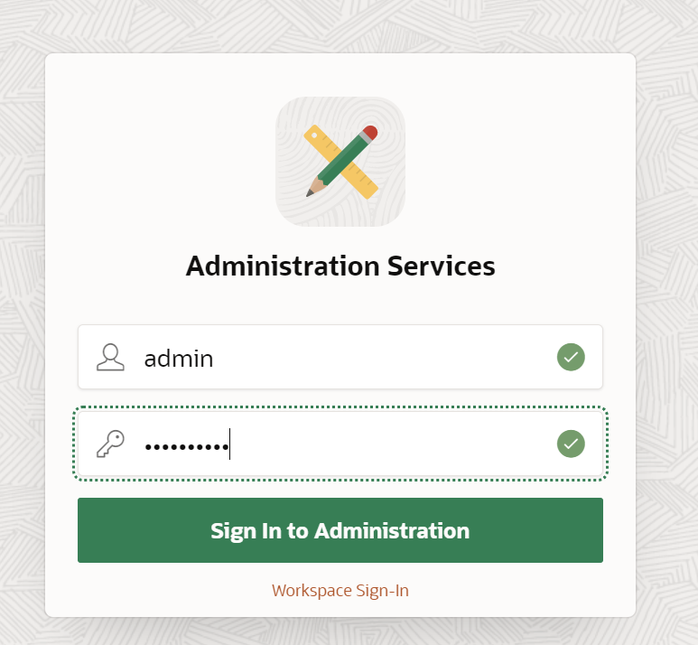
admin
Abc123456!

Slide 15
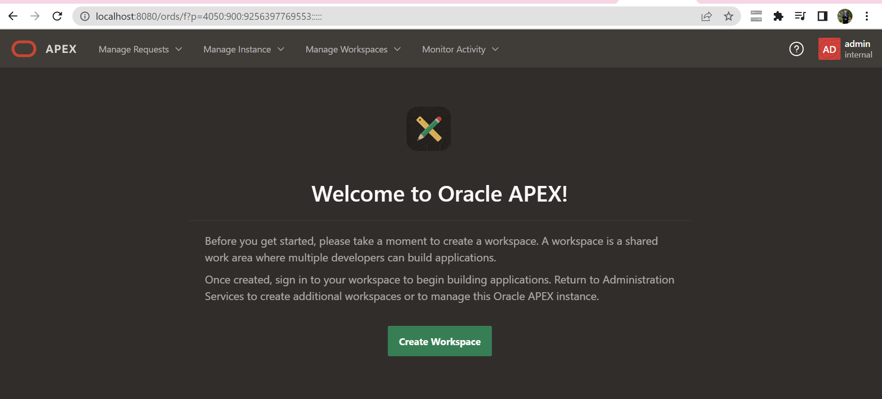
Welcome Admin Page

Slide 16
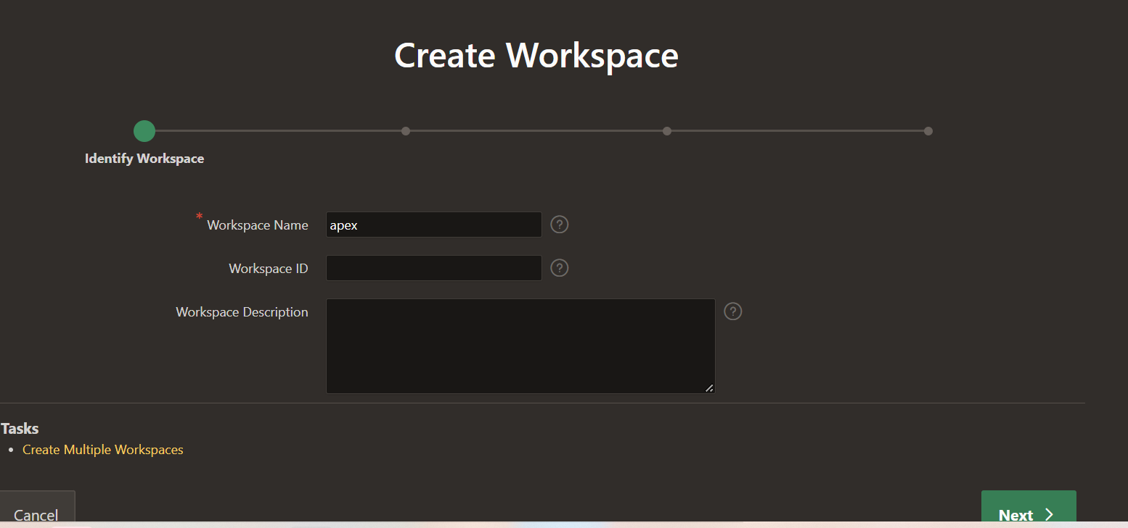
Create Workspace

Slide 17
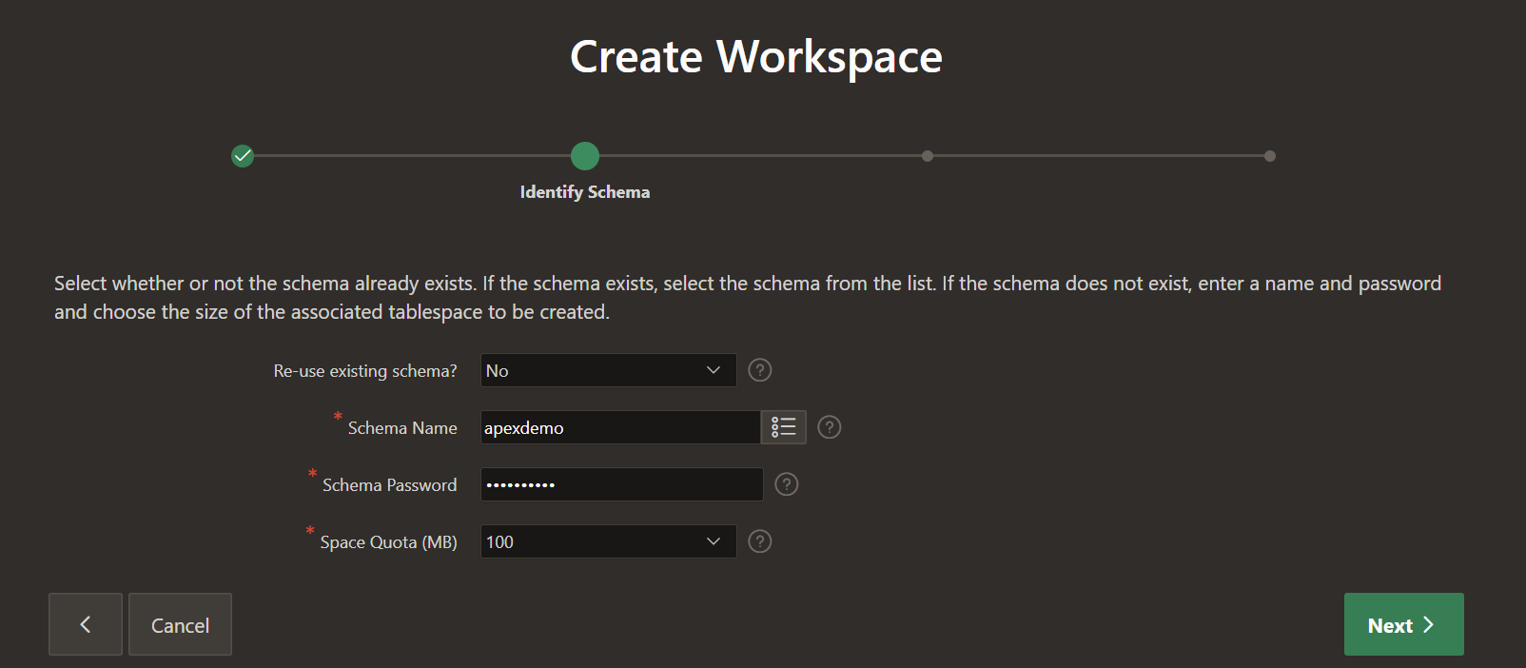
Create Schema
Name of schema/user: apexdemo
password of schema/user: Abc123456!

Slide 18
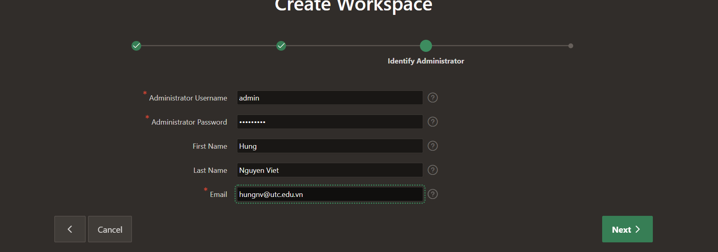
Create user to manager workspace

Slide 19
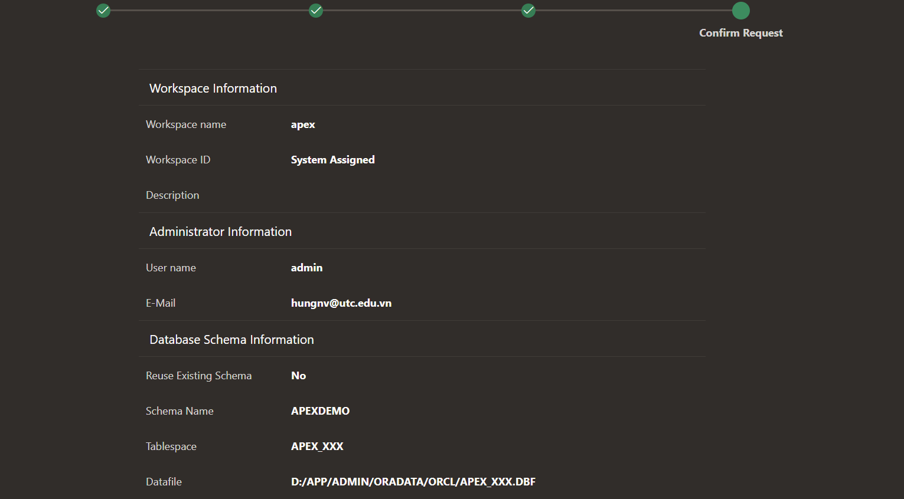
Information summary

Slide 20
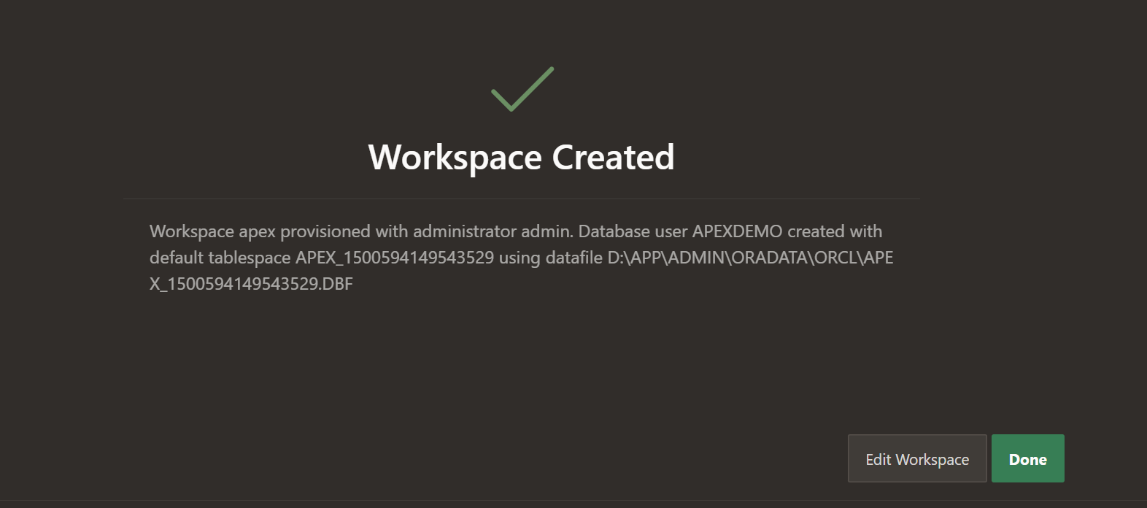

Slide 21
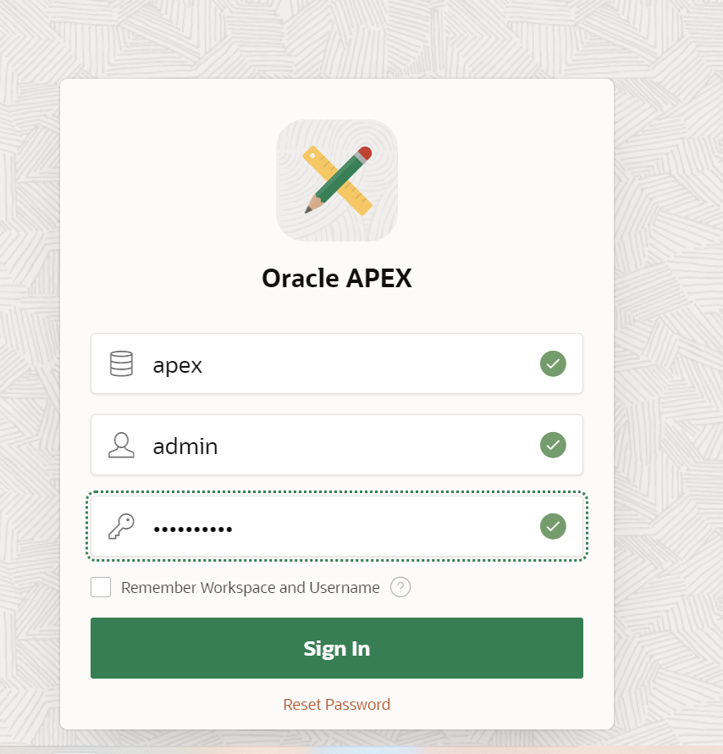
Sign out and sign in again

Slide 22
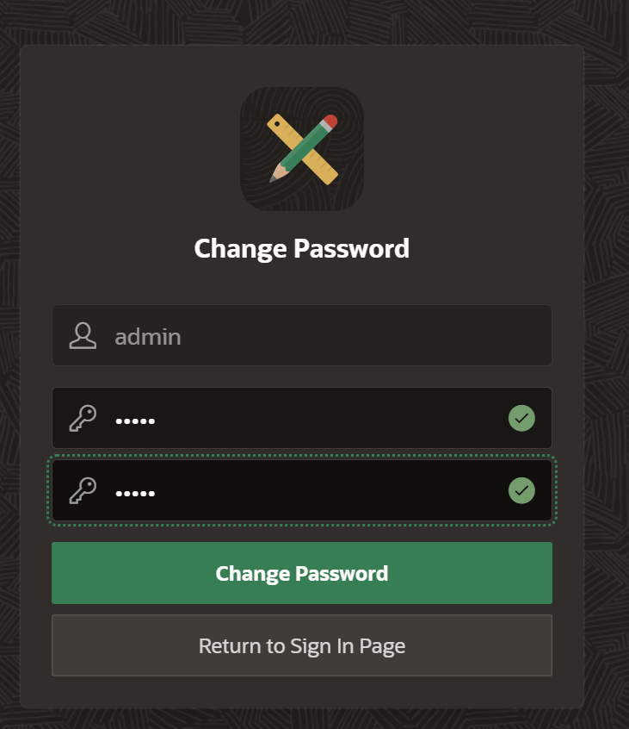
Change password first time login
admin/admin

Slide 23
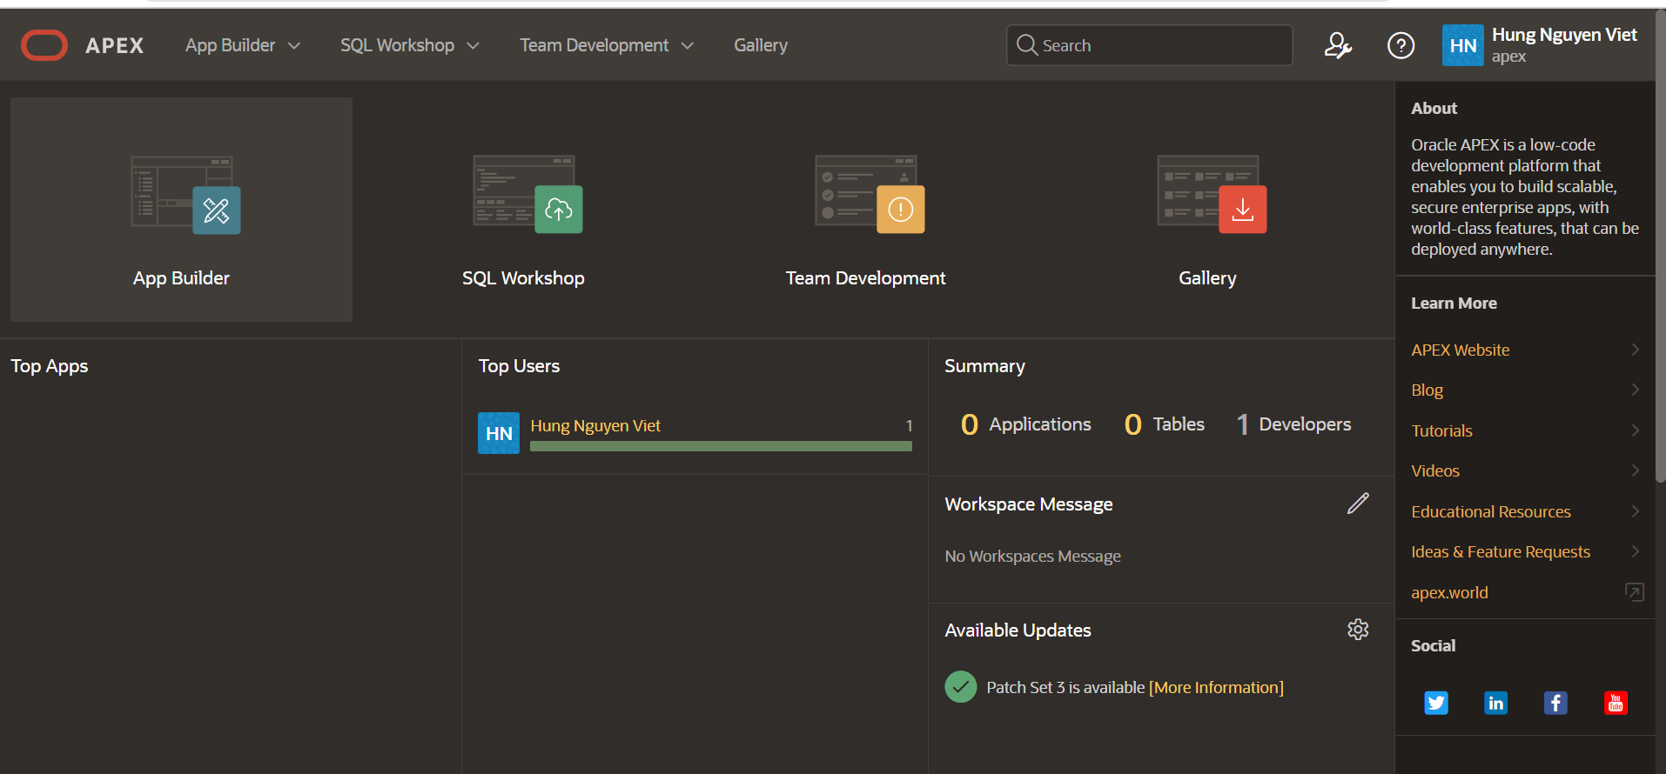
The admin page

Slide 24
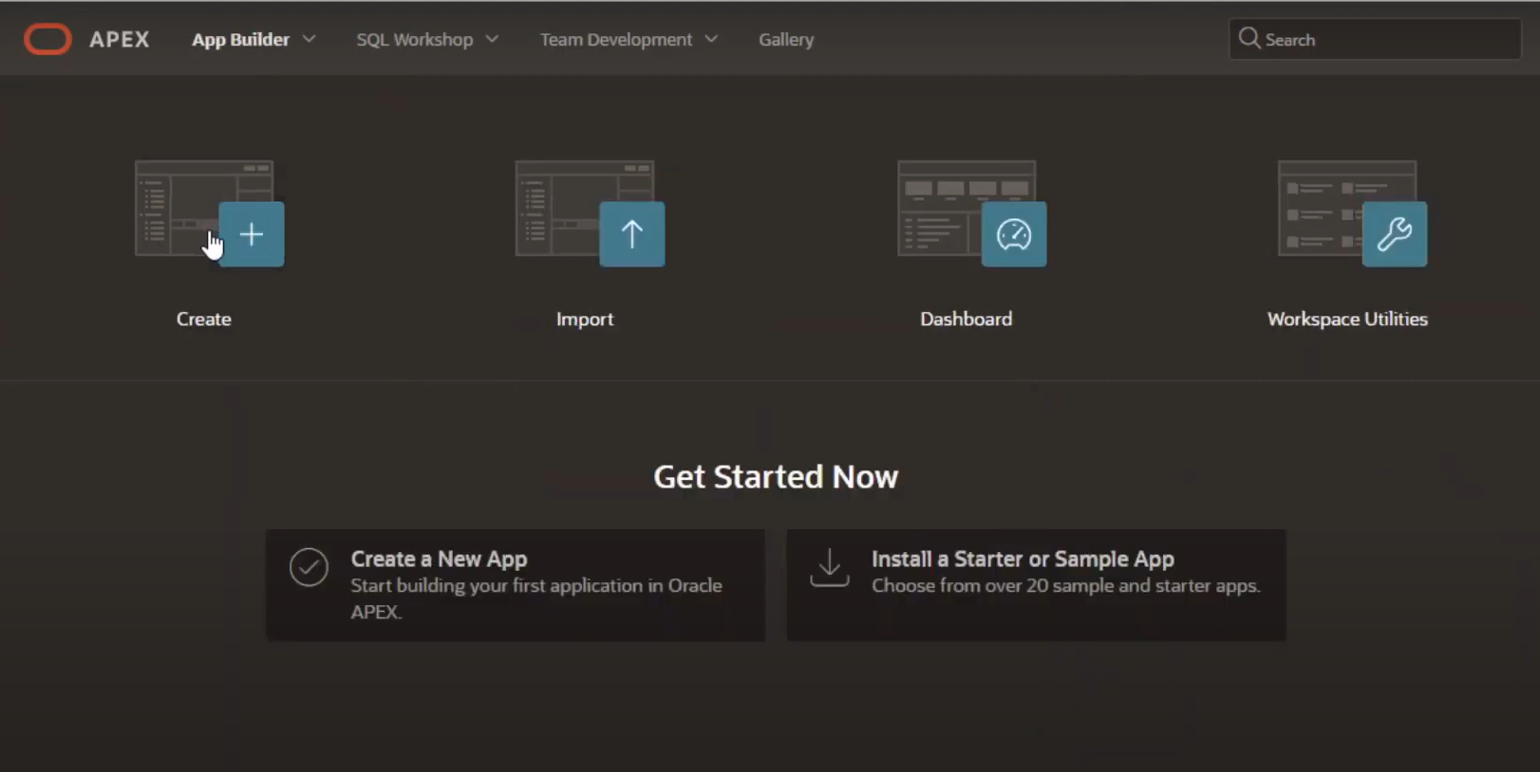
Install a Starter or Samle App

Slide 25
Caution! To Starting Server ORDS again, Change directory where ords.war is present & run below command:
java -jar ords.war --config D:/ords/config serve

